Slide 1
Causes and Mitigations of Unreproducible Builds in Java
Canonicalization for Unreproducible Builds in Java
Aman Sharma, Benoit Baudry, Martin Monperrus

Slide 2
Who am I?
Indian Institute of Technology Roorkee, India
• Received Bachelor of Technology in 2021
• Was a part of Information Management Group
KTH Royal Institute of Technology, Sweden
• Joined as a Research Engineer in 2021
• Worked on Sorald, Collector-Sahab SBOM.exe, and other projects in the
research group
• Switched to a PhD student in February 2023
• Funded by CHAINS to work on Software Supply Chain Security
• Supervised by Martin Monperrus and Benoit Baudry
06-05-2025
Aman Sharma | amansha@kth.se

Slide 3
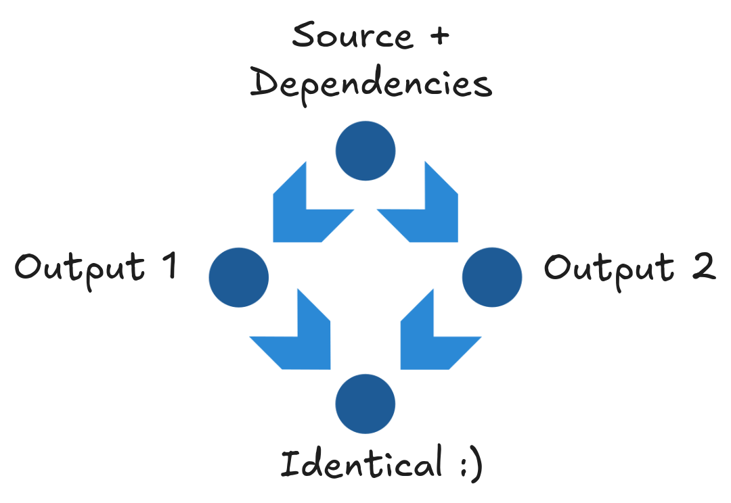
What is Reproducible Builds?
Build Reproducibility is a property of a software build process where the output artifact is bit-by-bit identical when built again, given a fixed version of source code and build dependencies, regardless of the environment [1].
[1] Chris Lamb and Stefano Zacchiroli. 2022. Reproducible Builds: Increasing the Integrity of Software Supply Chains. IEEE Software 39, 2 (March 2022), 62–70. https://doi.org/10.1109/MS.2021.3073045
06-05-2025
Aman Sharma | amansha@kth.se
Notes:
Could have two types of reproducible builds

Slide 4
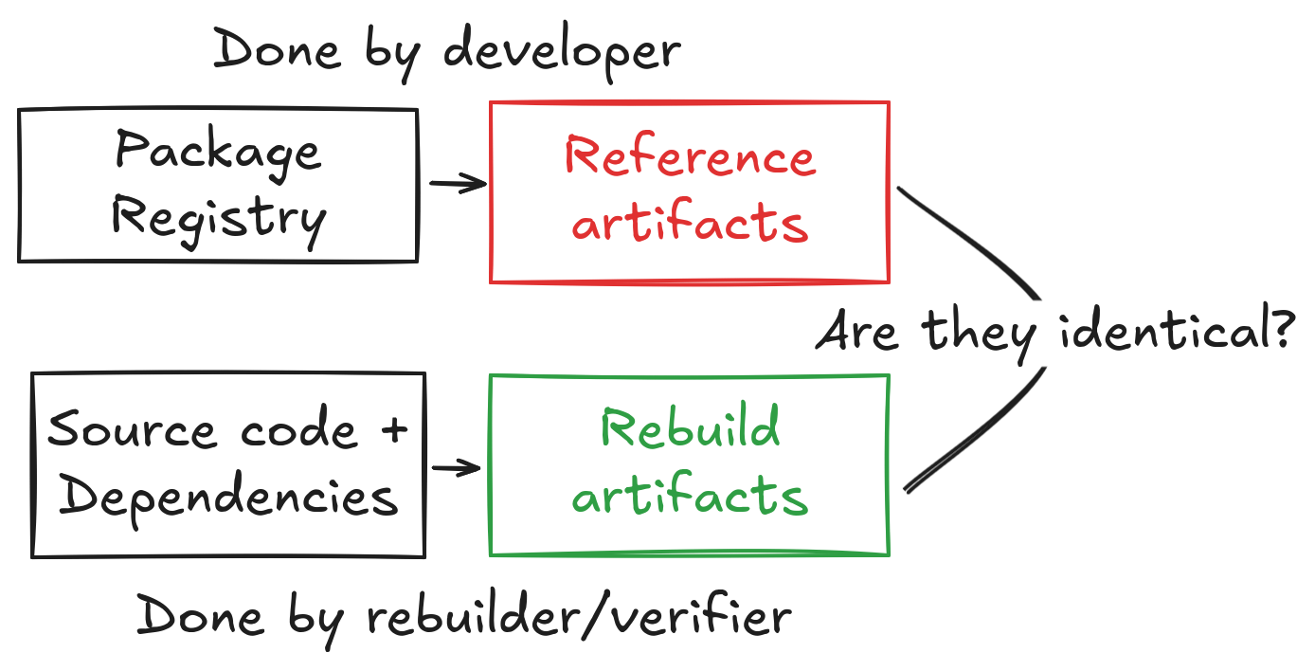
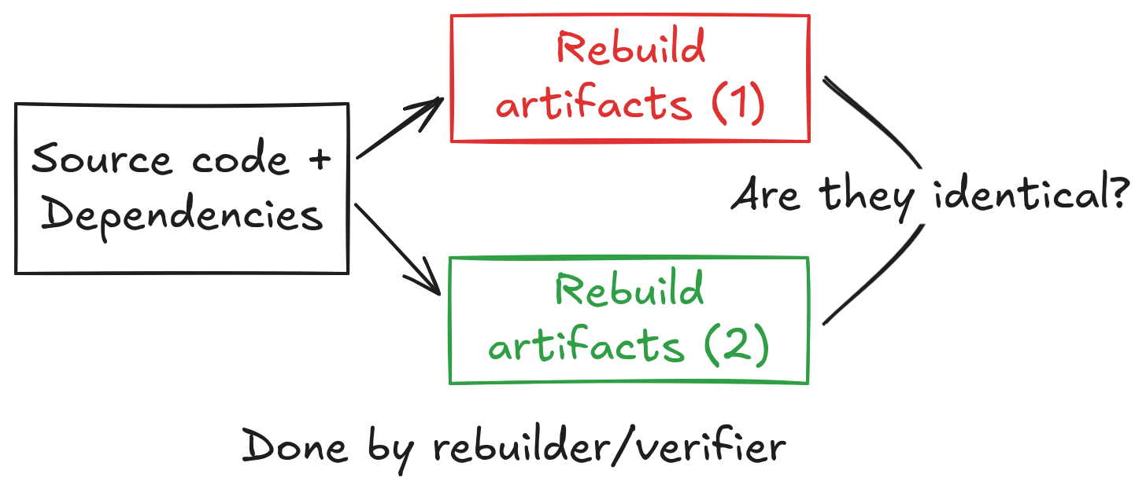
How to check for reproducible builds?
Build twice and compare
Build and compare with package registry
[2] G. Benedetti et al., ‘An Empirical Study on Reproducible Packaging in Open-Source Ecosystems’, 57th International Conference on Software Engineering, 2025.
[3] J. Malka, S. Zacchiroli, and T. Zimmermann, ‘Does Functional Package Management Enable Reproducible Builds at Scale? Yes’, in 22nd International Conference on Mining Software Repositories, Ottawa
06-05-2025
Aman Sharma | amansha@kth.se
Notes:
Add references to different papers

Slide 5
Related Work: build twice and compare
[4] G. Benedetti et al., ‘An Empirical Study on Reproducible Packaging in Open-Source Ecosystems’, presented at the Proceedings of the 47th International Conference on Software Engineering, 2025.
Summary: Checking if builds are reproducible for RubyGems, PyPI, Maven.
[5] Z. Ren, H. Jiang, J. Xuan, and Z. Yang, ‘Automated localization for unreproducible builds’, in Proceedings of the 40th International Conference on Software Engineering, 2018
Summary: Localizing files that differ in two subsequent builds for Debian packages.
[6] O. S. Navarro Leija et al., ‘Reproducible Containers’, in Proceedings of the Twenty-Fifth International Conference on Architectural Support for Programming Languages and Operating Systems, 2020
Summary: Wrapper around the build process for debian packages.
06-05-2025
Aman Sharma | amansha@kth.se

Slide 6
Related Work: build and compare with package registry
[7] J. Malka, S. Zacchiroli, and T. Zimmermann, ‘Does Functional Package Management Enable Reproducible Builds at Scale? Yes’, in 22nd International Conference on Mining Software Repositories, 2025.
Summary: Rebuild and verified 700K nix packages. 91% of them are reproducible.
[8] R. Bajaj, E. Fernandes, B. Adams, and A. E. Hassan, ‘Unreproducible builds: time to fix, causes, and correlation with external ecosystem factors’, Empirical Softw. Engg, 2023.
Summary: Reproducibility and survival analysis of Debian and Arch Linux packages. Debian packages takes longer to become reproducible but stay reproducible for longer.
[9] V. Andersson, Geth Rebuild : Verifiable Builds for Go Ethereum. 2024
Summary: Rebuilds ethereum client that enables connection to the main ethereum network.
We like this approach more as it maximizes environment differences!
06-05-2025
Aman Sharma | amansha@kth.se

Slide 7
Reproducible/Verifiable/Accountable builds
Verifiable Builds: Builds are verifiable if the build process of a software can be fixed to output bit-by-bit identical artifacts.
Accountable Builds: Builds are accountable if it can be explained why build process outputs unequal artifacts [10].
Basically, both of them are reproducible builds with extra steps hence we choose Reproducible Builds in our entire study.
We always prefer “Reproducible Builds” over other terms.
[10] T. Pohl, P. Novák, M. Ohm, and M. Meier, ‘SoK: Towards Reproducibility for Software Packages in Scripting Language Ecosystems’, Mar. 27, 2025, arXiv: arXiv:2503.21705. doi: 10.48550/arXiv.2503.21705.
06-05-2025
Aman Sharma | amansha@kth.se

Slide 8
Why is it important?
Ensuring Integrity: Reproducible builds ensure that the executable corresponds to the source code (assuming source code can be audited) and hence is not tampered with. [11]
Faster builds: Dependent packages do not need to be rebuilt and dependent tasks do not need to be rerun if a rebuild of a package does not yield different results. [12]
Patch updates: Only changes in source code (or dependencies) will lead to differences in the generated binaries thus reducing storage requirements. [12]
[11] Mike Perry. 2013. Deterministic Builds Part One: Cyberwar and Global Compromise | Tor Project. https://blog.torproject.org/deterministic-builds-part-one-cyberwar-and-global-compromise/
[12] https://reproducible-builds.org/
06-05-2025
Aman Sharma | amansha@kth.se

Slide 9
Why is it important? XZ Utils backdoor example
What?
Malicious code was introduced in the Linux build (tarball) of `xz` that enabled remote SSH access to the attacker.
How serious?
Extremely. Used in xz compression tool that outputs .tar.xz. But it was detected when new versions of Linux distros were in development phase.
How can reproducible builds detect such attacks?
[13] J. Malka, ‘How NixOS and reproducible builds could have detected the xz backdoor for the benefit of all’. Available: https://luj.fr/blog/how-nixos-could-have-detected-xz.html
06-05-2025
Aman Sharma | amansha@kth.se
Notes:
Question for Julien: Maintainer provided tar ball where?
And is the difference in configure scripts
Make it more with the visuals

Slide 10
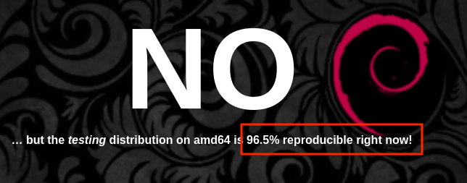
Are builds reproducible yet?
[14]
[14] P. Goswami, S. Gupta, Z. Li, N. Meng, and D. Yao, ‘Investigating The Reproducibility of NPM Packages’, in 2020 IEEE International Conference on Software Maintenance and Evolution (ICSME)
06-05-2025
Aman Sharma | amansha@kth.se
Notes:
https://reproducible.archlinux.org/
https://tests.reproducible-builds.org/debian/reproducible.html
Nix paper

Slide 11
Why aren’t builds reproducible?
Short answer: Timestamps, signature embedded
[15] R. Bajaj, E. Fernandes, B. Adams, and A. E. Hassan, ‘Unreproducible builds: time to fix, causes, and correlation with external ecosystem factors’, Empirical Softw. Engg.
06-05-2025
Aman Sharma | amansha@kth.se

Slide 12
What is the status of reproducible builds in Java?
Most closely related work:
[16]J. Xiong, Y. Shi, B. Chen, F. R. Cogo, and Z. M. (Jack) Jiang, ‘Towards build verifiability for Java-based systems’, in Proceedings of the 44th International Conference on Software Engineering: Software Engineering in Practice, in ICSE-SEIP ’22
1) Follows “build twice and compare” 2) Small and close sourced dataset
[16] P. Goswami, S. Gupta, Z. Li, N. Meng, and D. Yao, ‘Investigating The Reproducibility of NPM Packages’, in 2020 IEEE International Conference on Software Maintenance and Evolution (ICSME)
06-05-2025
Aman Sharma | amansha@kth.se

Slide 13
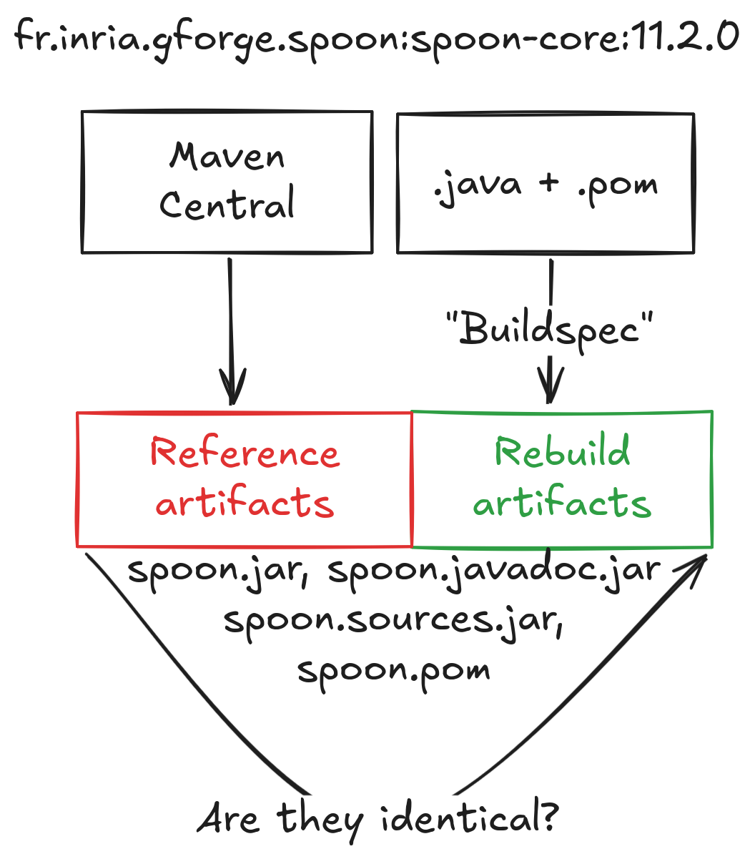
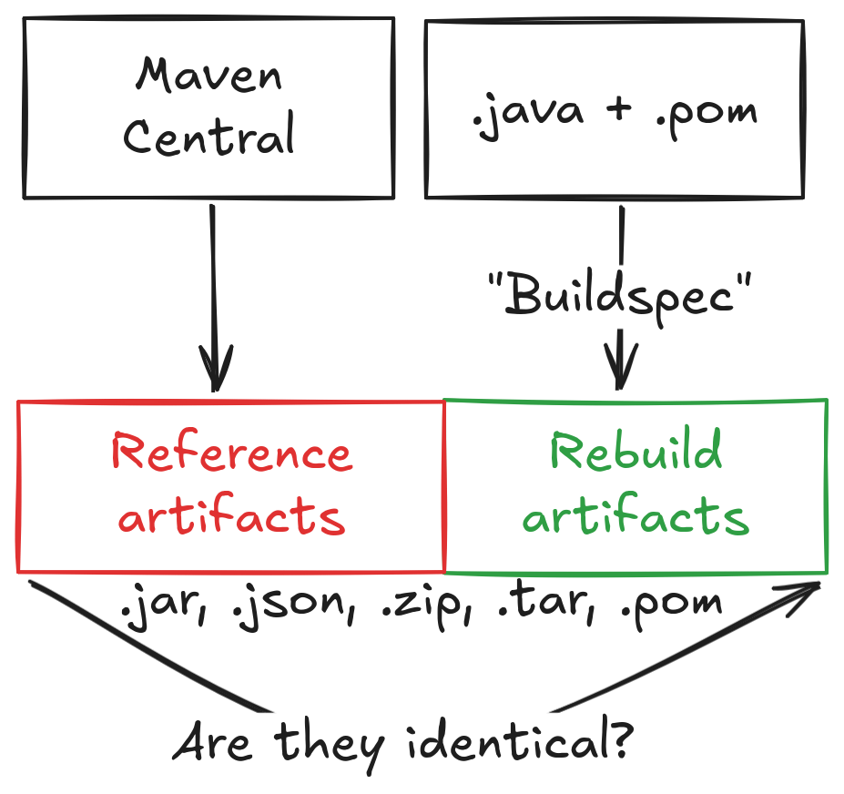
Reproducible Central
It is a GitHub repository: https://github.com/jvm-repo-rebuild/reproducible-central/
Artifacts like jar, .json, .zip files are downloaded from Maven Central.
Source code is downloaded from hosting services like GitHub.
The source code along with all of its build requirement is built using a “buildspec”.
Buildspec file is specification that lists how the build should done
Build command
Java version
Environment variables
If corresponding reference and rebuild artifacts are identical, project is marked reproducible.
[17] H. Boutemy, jvm-repo-rebuild/reproducible-central. (Oct. 31, 2024). jvm-repo-rebuild.
06-05-2025
Aman Sharma | amansha@kth.se

Slide 14
Our first goal
To build a taxonomy of reasons why unreproducible builds occur in Java and propose a fix for them
06-05-2025
Aman Sharma | amansha@kth.se

Slide 15
Dataset
We build our dataset on top of Reproducible Central - it is an infrastructure to verify whether Maven projects are reproducible.
Snapshot Reproducible Central on 8th October, 2024 (d280bf1)
706 Maven projects and their buildspec files
We apply four filters that resulted in exclusion of projects
Projects that require manual intervention (eg. setting precise Java version).
Projects that have more artifacts built locally than on package registry (eg. some jars are are built locally but never released).
Projects that do not use Maven as build tool.
Projects that mapped artifacts incorrectly (eg. pom file is compared with jar).
Finally, we have
7,961 Maven releases of submodules
12,283 unreproducible artifact pairs
06-05-2025
Aman Sharma | amansha@kth.se

Slide 16
RQ1: Causes of Unreproducibility
06-05-2025
Aman Sharma | amansha@kth.se
Notes:
Why

Slide 17
Mitigation Strategies
There are 3 mitigation strategies
Fix the build process: repairing the build script used by developer to publish package
Pros: anyone can replicate the build with 0 ad-hoc configuration
Cons: sometimes you have to embed non-deterministic information like signatures
Fix the rebuild process: repairing the buildspec file
Pros: contributes to fixes in the build process
Cons: can be hard to adapt for future releases
Canonicalization: conversion of output artifacts into a standard representation that is free of non-deterministic changes
Pros: past releases can also be verified, no need to rebuild, “i can’t find a jdk 14 nowadays”
Cons: careful removal as it may mask meaningful differences
We try to evaluate canonicalization since few work in the literature
[18] J. Dietrich, T. White, B. Hassanshahi, and P. Krishnan, ‘Levels of Binary Equivalence for the Comparison of Binaries from Alternative Builds’
06-05-2025
Aman Sharma | amansha@kth.se

Slide 18
Example: Build Manifest
// rg.apache.camel:came-ahc-ws:3.13.0
// Built-By: name of user that built the artifact
-Built-By: root
+Built-By: aman
Mitigation: Fix build process or canonicalize
// org.apache.any23:apache-any23-csvutils:
2.7
-Specification-Title: Apache Any23 :: CSV Utilities
-Specification-Version: 2.7
-Specification-Vendor: The Apache Software Foundation
-Implementation-Title: Apache Any23 :: CSV Utilities
-Implementation-Version: 2.7
-Implementation-Vendor: The Apache Software Foundation
... some more attributes
06-05-2025
Aman Sharma | amansha@kth.se

Slide 19
Build Manifest mitigation
or
-Built-By: root
+Built-By: foo
-Built-By: root
// reference
-Built-By: root
// rebuild
+Built-By: aman
Diff between canonicalized artifact
Now Identical!
-Built-By: aman
+Built-By: foo
-Built-By: aman
Diff between original
reference and rebuild
artifacts
or
06-05-2025
Aman Sharma | amansha@kth.se

Slide 20
Example: Software Bill of Materials
// org.apache.commons:commons-parent:61
- <hash alg=\"SHA3-384\">289f952[TRUNCATED]</hash>
- <hash alg=\"SHA3-256\">32b50a7[TRUNCATED]</hash>
- <hash alg=\"SHA3-512\">1daf813[TRUNCATED]</hash>
Reason: Azul JDK had backported these hash algorithms.
Mitigation: Fix build process by correcting the Java vendor
06-05-2025
Aman Sharma | amansha@kth.se

Slide 21
Example: Filesystem
// io.github.albertus82:unexepack:0.2.1
// change in file permissions and owner
--rw-r--r-- root unexepack-0.1.1/unexepack.jar
+-rw-rw-r-- aman unexepack-0.1.1/unexepack.jar
Mitigation: Set permissions and owner to fixed value (canonicalization)
06-05-2025
Aman Sharma | amansha@kth.se

Slide 22
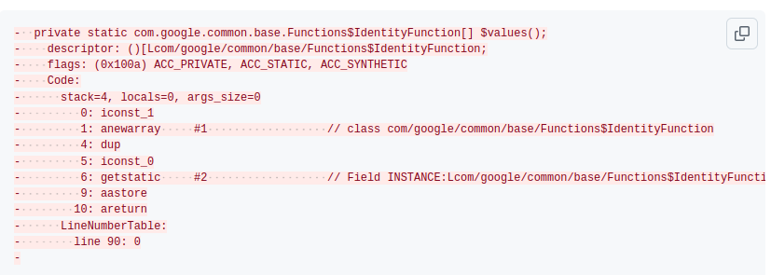
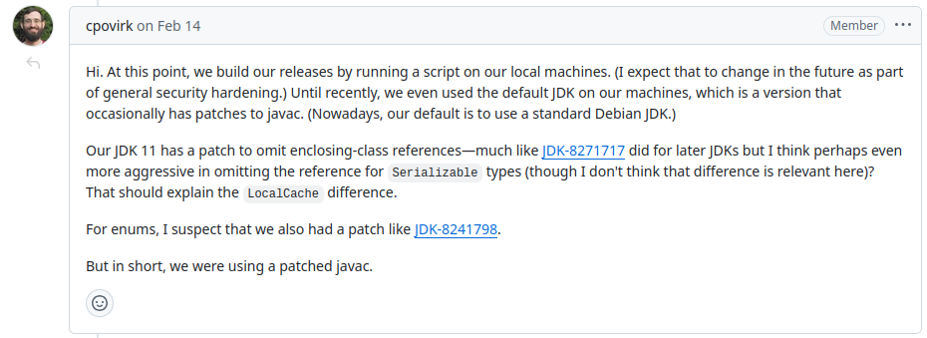
JVM bytecode
Mitigation: Hard to find JDK in such cases. It is better to consider two implementations equivalent (canonicalize).
06-05-2025
Aman Sharma | amansha@kth.se

Slide 23
Versioning Properties
// com.github.ldapchai:ldapchai:0.8.6
// Embedded in MANIFEST.MF
-SCM-Git-Branch: master
+SCM-Git-Branch: 338023a
// org.apache.drill:drill-opentsdb-storage:1.21.0
// Embedded in git.properties
-git.tags=drill-1.21.0
+git.tags=drill-1.21.0,drill-1.21.1,drill-1.21.2
Mitigation: Remove such attributes (canonicalization).
06-05-2025
Aman Sharma | amansha@kth.se

Slide 24
Timestamps
-#Wed Apr 20 20:27:41 CEST 2022
+#Fri Oct 18 03:03:44 UTC 2024
they can be embedded in the properties file
generated documentation
shell scripts appendix
executable binaries
software bill of materials
JVM bytecode
file metadata
MANIFEST.MF
NOTICE
servlets created by Jasper JSP compiler
Mitigation: Add `project.build.outputTimestamp` property to pom so that plugins can respect it (fixing build process)
06-05-2025
Aman Sharma | amansha@kth.se

Slide 25
RQ1: Causes of Unreproducibility
Takeaway: 6 main reasons of unreproducibility in Java
06-05-2025
Aman Sharma | amansha@kth.se
Notes:
Why

Slide 26
Our second goal
Analyze effectiveness of canonicalization in mitigating unreproducible builds
06-05-2025
Aman Sharma | amansha@kth.se

Slide 27
What is this term “canonicalization”?
Inspired by canonical URL. To choose the preferred, representative URL for a web page, helping search engines understand which version of a page should be indexed [19].
Also, used in previous work to detect allowlisted classes at runtime.
In our context, we create a preferred representation of the artifact which abstracts away non-deterministic differences.
Removing parts of artifacts
Setting fixed values
[20]
[19] https://support.google.com/webmasters/answer/10347851?hl=en
[20] A. Sharma, M. Wittlinger, B. Baudry, and M. Monperrus, ‘SBOM.EXE: Countering Dynamic Code Injection based on Software Bill of Materials in Java’, Jun. 28, 2024, arXiv: arXiv:2407.00246.
06-05-2025
Aman Sharma | amansha@kth.se

Slide 28
Artifact Canonicalization
Bytecode Canonicalization
It means that the entire artifact is transformed by removing non-deterministic and spurious changes, especially in metadata.
Eg. ordering of files in archive is made consistent
Tool used: OSS-Rebuild [21]
It is a process of transforming the bytecode of a program into a representation that is independent of specific implementation details inserted by the compiler.
Eg. implementation of string concatenation pre and post Java 9
Tool used: jNorm [22]
[21] https://github.com/google/oss-rebuild
[22] S. Schott, S. E. Ponta, W. Fischer, J. Klauke, and E. Bodden, ‘Java Bytecode Normalization for Code Similarity Analysis’
06-05-2025
Aman Sharma | amansha@kth.se

Slide 29
RQ2: Effectiveness of Artifact Canonicalization
OSS-Rebuild: Tool by Google to canonicalize software artifacts.
CHAINS-Rebuild: Fork of OSS-Rebuild with support for canonicalizing build manifests and embedded versioning properties.
06-05-2025
Aman Sharma | amansha@kth.se

Slide 30
RQ2: Effectiveness of Artifact Canonicalization
Takeaway: 2.5x increase in canonicalized artifacts with only a few improvements.
OSS-Rebuild: Tool by Google to canonicalize software artifacts.
CHAINS-Rebuild: Fork of OSS-Rebuild with support for canonicalizing build manifests and embedded versioning properties.
06-05-2025
Aman Sharma | amansha@kth.se

Slide 31
RQ3: Effectiveness of Bytecode Canonicalization
We select a subset of unreproducible artifacts that have JVM bytecode changes.
This is 898/12,283 artifact pairs.
Reasons of failure:
Structural Changes limitation (eg. changes in order of methods, fields, etc)
Control flow limitation (eg. ifne and ifeq)
Embedded data (eg. absolute file paths)
Optimization limitation (eg. string concatenation)
 | Successful canonicalization | Failure in canonicalization | Error in canonicalization
# | 267 (29.7%) | 478 (53.2%) | 153 (17.1%)
06-05-2025
Aman Sharma | amansha@kth.se

Slide 32
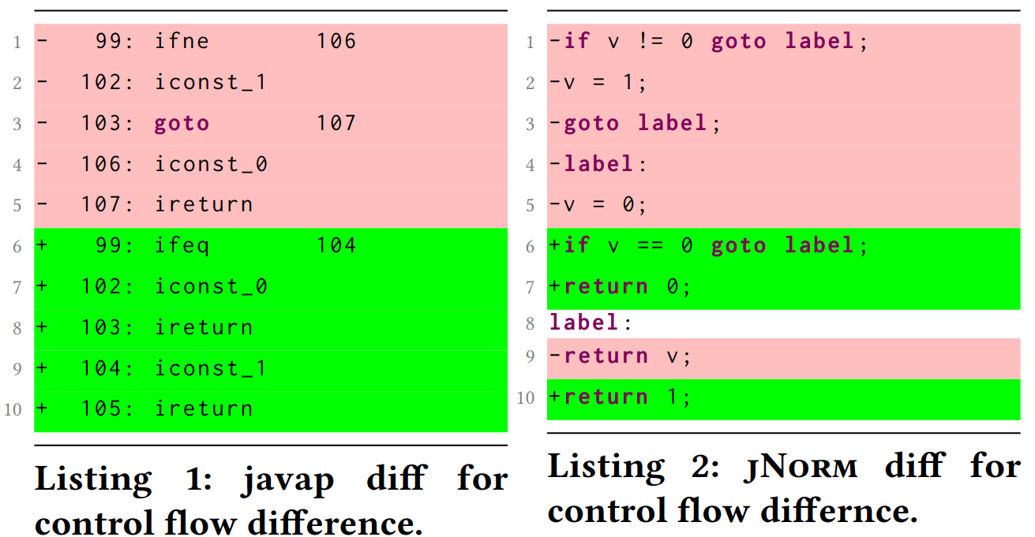
Example diff for jNorm and oss-rebuild
06-05-2025
Aman Sharma | amansha@kth.se

Slide 33
RQ3: Effectiveness of Bytecode Canonicalization
We select a subset of unreproducible artifacts that have JVM bytecode changes.
This is 898/12,283 artifact pairs.
Reasons of failure:
Structural Changes problems (eg. changes in order of methods, fields, etc)
Control flow problems (eg. ifne and ifeq)
Embedded data (eg. absolute file paths)
Optimization problem (eg. string concatenation)
Takeaway: 4 categories of improvements for bytecode canonicalization.
 | Successful canonicalization | Failure in canonicalization
# | 267 (29.7%) | 487 (53.2%)
06-05-2025
Aman Sharma | amansha@kth.se

Slide 34
Future Work
Formalize the notion of acceptable canonicalization; what to remove and what to keep?
Correctness of canonicalization via running tests.
More features for canonicalization in OSS-Rebuild.
Integration of canonicalization into Reproducible Central infrastructure?
After canonicalization
10 5 59/0
06-05-2025
Aman Sharma | amansha@kth.se

Slide 35
Conclusion
A comprehensive taxonomy of unreproducible builds in Java and their mitigation.
Artifact and bytecode canonicalization in conjunction can be used to mitigate unreproducibility.
06-05-2025
Aman Sharma | amansha@kth.se

Slide 36
Thank you!
Aman Sharma
amansha@kth.se
Paper:
Canonicalization for Unreproducible Builds in Java
06-05-2025
Aman Sharma | amansha@kth.se

