Slide 1
Software Supply Chain Security at Runtime
Whitepaper: SBOM.EXE: Countering Dynamic Code Injection based on Software Bill of Materials in Java
Aman Sharma, Martin Wittlinger, Benoit Baudry, Martin Monperrus
Notes:
Introduce yourself
Say the title and say it is a presentation about an ongoing project
Say the slides are on my website
Foundation is there all slides are there
High level structure:
Related work could be at the beginning. Motive: I did my research (think about it). Also tell short comings in the approach.
the demo can be in the beginning. Don't show ldap server. this is remote code exection as bytecode is injected
Xthe solution demo des not need json with hashes
Show paper here (authors, year, title, and link) and last slide

Slide 2
Outline
Background about Software Supply Chain and Java
Demo of log4shell exploit
Related Work
Novel Tool: SBOM.EXE: Countering Dynamic Code Injection based on Software Bill of Materials in Java
Demo of log4shell mitigation
Evaluation
Future Work
Conclusion

Slide 3
What is Software Supply Chain?
Execute
What developers write
Source
Software package is created
Software packaged is stored
Build
Registry
Execute
Dependency
Dependency
Execute
Dependency
Software Reuse
What developers declare
Notes:
Should show the deployment execution
Here we miss production and deployment
This is the part where log4shell attack happened

Slide 4
What is Software Supply Chain Attack?
Execute
[1]
Source
Source
?
[2]
[4]
Build
Registry
Execute
Build
Registry
?
?
[3]
Dependency
Malicious Payload!
Dependency
Dependency
Dependency
Execute
Dependency
Dependency
?
[1] Q. Wu et al. “On the Feasibility of Stealthily Introducing Vulnerabilities in Open-Source Software via Hypocrite Commits”, 2021
[2] S. Peisert et al. “Perspectives on the solarwinds incident,” IEEE Security Privacy, 2021
[3] P. Ladisa et al. Towards the Detection of Malicious Java Packages. In Proceedings of the 2022 ACM Workshop on Software Supply Chain Offensive Research and Ecosystem Defenses, 2022
[4] J. Cappos et al. “A look in the mirror: attacks on package managers,” in Proceedings of the 15th ACM conference on Computer and communications security, 2008
Notes:
Or nothing is wrong, you simply get pwned by a malicious playload and you are wondering who is resposible

Slide 5
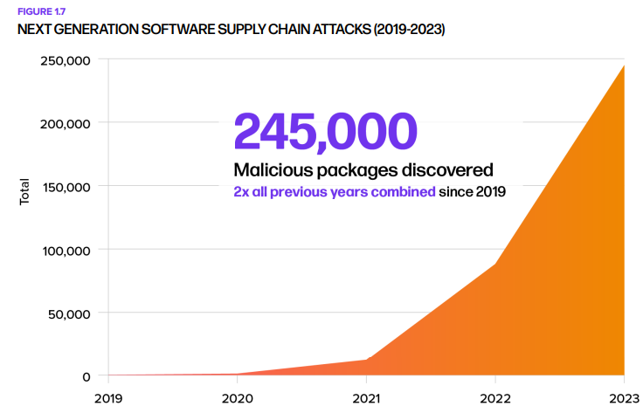
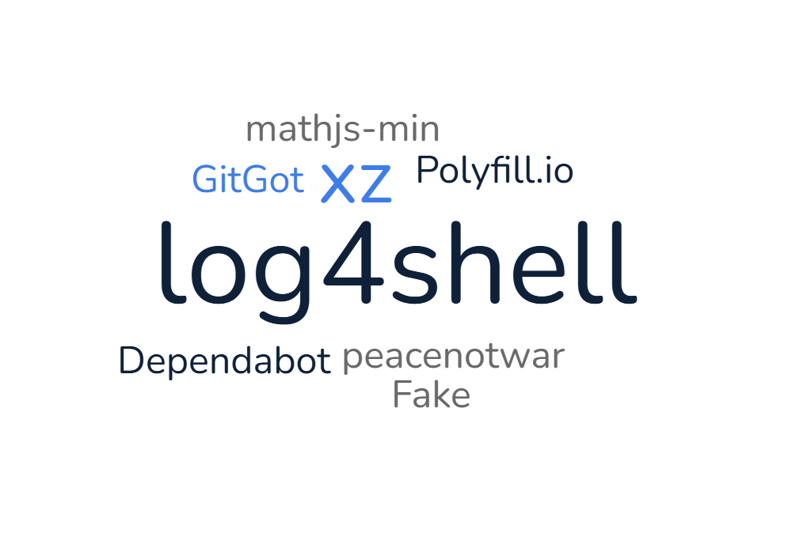
How prevalent Software Supply Chain attacks are?
2023 saw twice as many software supply chain attacks as 2019-2022 combined [5].
[5] Sonatype. 9th Annual State of the Software Supply Chain. October (2023)
Notes:
Log4shell is in Java so let’s undreestand in the context of Java

Slide 6
Intricacies of Java: Build
Foo.java
Bar.java
Source
// project.jar
// compiled from source
Foo.class
Bar.class
// aggregated from dependency
Baz.class
Qux.class
Build
$ java –jar project.jar
> “See next slide ☺”
Dependency
Baz.class
Qux.class
Jar file is bunch of classfile bundled together.

Slide 7
Intricacies of Java: Runtime
We, java lovers, just call the entire process classloading.
Java Virtual Machine
> So much for hello world :/
[6]
Loading
Linking
Initialization
// Qux.class
return
// Bar.class
ldc
// Foo.class
getstatic
// Baz.class
invokevirtual
// Foo.class
getstatic
// Bar.class
Ldc
// Baz.class
invokevirtual
// Qux.class
return
1010101010101011010101010101010101101010101010101010110101010010001010101010101010101010101010101011010101010110
Jar from registry.
Gets binary represenation
Combines into runtime state
Ready for execution!
[6] Oracle, Chapter 5. Loading, Linking, and Initializing (oracle.com), 2023, https://docs.oracle.com/javase/specs/jvms/se21/html/jvms-5.html
Notes:
Maybe I am wrong about the visualization but the best way to learn is to be corrected.

Slide 8
How is Software Supply Chain Attack relevant?
Loading
Linking
Initialization
// Qux.class
return
// Bar.class
ldc
// Foo.class
getstatic
// Baz.class
invokevirtual
// Quux.class
steal
// Foo.class
getstatic
// Bar.class
Ldc
// Baz.class
invokevirtual
// Qux.class
return
// Quux.class
steal
10101010101010110101010101010101011010101010101010101101010100100010101010101010101010101010101010110101010101100110
10101010101011
Source
Remote Source
...
Runtime Generation
Dependency
Dynamic classloading could be exploited!!!
Code can be downloaded at runtime.
Code can be generated at runtime. [7]
[7] Oracle, ClassLoader (Java SE 21 & JDK 21) (oracle.com), 2023, https://docs.oracle.com/en%2Fjava%2Fjavase%2F21%2Fdocs%2Fapi%2F%2F/java.base/java/lang/ClassLoader.html#builtinLoaders
Notes:
I may be wrong about the visualizations

Slide 9
Demo: Exploitation
CVE-2021-44228 (Log4Shell)
Source: https://github.com/chains-project/exploits-for-sbom.exe/tree/main/rq2/log4shell-2021-44228
Notes:
Lets see the application it is a toy project
It can also be used for defining and loading classes
Let’s see how
To prevent it we run the two steps that we discussed before

Slide 10
Demo Steps (for replication later) for exploit
Make sure Java 17 (or earlier) is on PATH.
Inspect code in src/main/java and run ./normal-usage.sh. This should log “this is an error”.
Now startup the LDAP server by going to root of the project and run java -jar target/RogueJndi-1.1.jar --command "gedit /etc/passwd".
This will inject the command argument in the bytecode that will be hosted on LDAP server.
Next, go back to the same directory where “normal-usage” was run. Run ./malicious-usage.sh. This will execute the malicious bytecode.

Slide 11
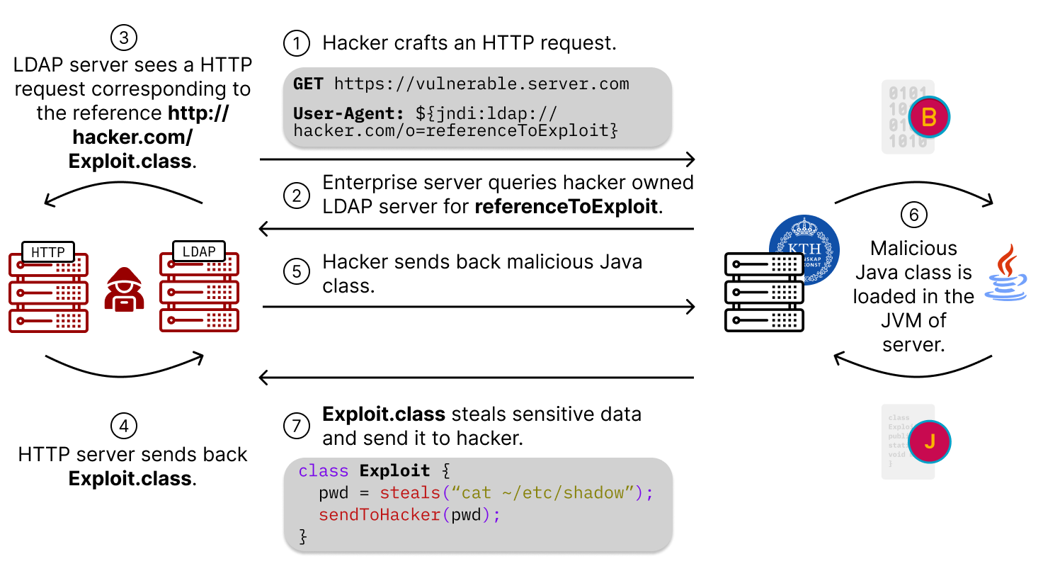
Log4Shell – a software supply chain attack at runtime
Notes:
Add animation for figure
Let’s try to zoom into 6

Slide 12
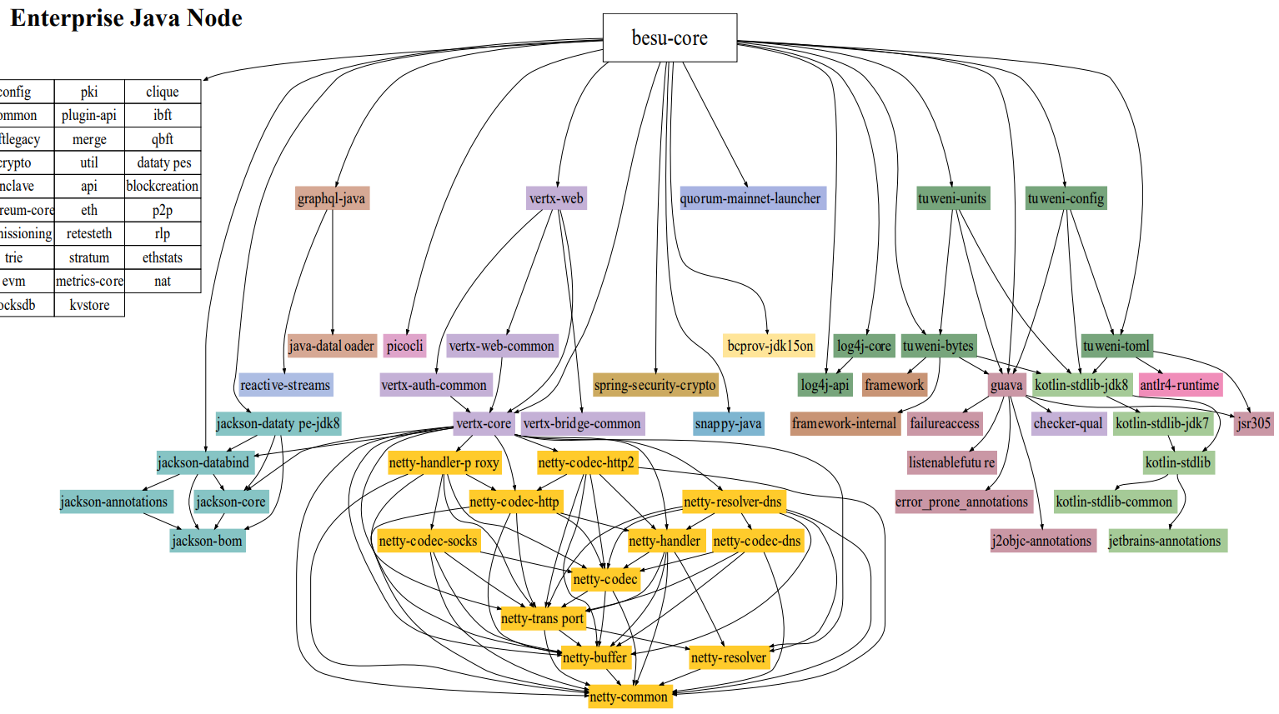
Why is Log4Shell a Software Supply Chain attack?
Only clue: it happened after execution with the malicious payload.
Source?
my_project
Build?
dependency
dependency
dependency
dependency
dependency
dependency
Registry?
[9]
dependency
log4j
Dependency
Dependency
Dependency
Log4J is one of the most popular logging libraries. [8]
?
[8] B. Chen et al. “Studying the use of Java logging utilities in the wild”. In Proceedings of the ACM/IEEE 42nd International Conference on Software Engineering (ICSE ‘20)
[9] C. Soto-Valero et al. “The Multibillion Dollar Software Supply Chain of Ethereum”, Computer, 2022

Slide 13
Problem: Java can trigger download or generation of unknown code.
Notes:
Make it a problem.
Related work can be just after.

Slide 14
Related Work: Permission Managers
Overview: Define access permissions for the application at varying granularities.
[10] P. C. Amusuo et al. “Preventing Supply Chain Vulnerabilities in Java with a Fine-Grained Permission Manager”, arXiv, 2023
Map network, filesystem, and process permissions to dependency.
[11] N. Vasilakis et al. “Preventing Dynamic Library Compromise on Node.js via RWX-Based Privilege Reduction”, In Proceedings of the 2021 ACM SIGSAC Conference on Computer and Communications Security, 2021
Map read, write, execute permissions to each field and method.
[12] Y. Xu et al. “SWAT4J: Generating System Call Allowlist for Java Container Attack Surface Reduction”, IEEE International Conference on Software Analysis, Evolution and Reengineering, 2024
Restrict invocation of system calls at runtime for different containers.
Shortcomings: 1) Setting permissions are susceptible to privilege escalation. 2) Requires modification to runtime, eg, JVM, node.js.
Notes:
Remove author names. Title venue year and only first authour

Slide 15
Related Work: Compartmentalization
Overview: Different parts of an application are executed in different protection domains
Hardware level compartmentalization
[13] J. Jiang et al. “Uranus: Simple, Efficient SGX Programming and its Applications”, Proceedings of the 15th ACM Asia Conference on Computer and Communications Security, 2020
Proposes API to run code on Intel Software Guard Extensions which is also called an enclave in CPU.
Software level compartmentalization
[14] C. Song et al. “Exploiting and Protecting Dynamic Code Generation”, Network and Distributed System Security Symposium, 2015
Enables to run trusted and untrusted parts in different processes.
Shortcomings: 1) Requires manual work to split code. 2) Context switch overhead could be high.

Slide 16
Related Work: Integrity Measurement
Overview: Measuring application in terms of its side effects, memory, or any kind of execution behavior.
Manual verification of integrity
[15] H. Ba et al. “RIM4J: An Architecture for Language-Supported Runtime Measurement against Malicious Bytecode in Cloud Computing”, Information Technology and Its Applications, 2021
Support for user to query the application for measurement and then subsequent verification.
Automated verification of integrity
[16] X. Wang et al. “RSDS: Getting System Call Whitelist for Container Through Dynamic and Static Analysis”, IEEE International Conference on Cloud Computing, 2020
Keeps a track of the allowlist of system calls that can be invoked.
Shortcomings: 1) Manual work of verifying integrity.
SBOM.exe falls under this category. It is the first automated tool for Java.

Slide 17
Related Work: Some more work on security
Control Flow Integrity: checking that the application executes according to the control flow graph as intended.
[17] N. Burow et al. “Control-Flow Integrity: Precision, Security, and Performance”, ACM Computing Surveys (CSUR), 2017
Oblivious Hashing: a technique where the side effects of executed code are verified.
[18] M. Ahmadvand, et al. “Practical Integrity Protection with Oblivious Hashing,” in Proceedings of the 34th Annual Computer Security Applications Conference, ser. ACSAC ’18, 2018
Deserialization Attacks: attacker sends a serialized object to the application and expects the application to deserialize it.
[19] I. Sayar et al. “An In-depth Study of Java Deserialization Remote-Code Execution Exploits and Vulnerabilities,” ACM Transactions on Software Engineering and Methodology, 2023
Notes:
Try to make it scoped
Something that can be removed later

Slide 18
Expectations from new approach
Minimal or no-modification to the runtime itself.
Should be fully automated – automatic detection and then proactive mitigation.
Minimal overhead.
Notes:
This can be contribution

Slide 19
Solution: Create an allowlist of classes and only load those classes
Notes:
Make it high level.
Todo: bytecode can

Slide 20
Step 1: Indexing
Problem: but, what to allowlist?
Solution: let’s go for built-in classes, source code, dependencies, and finally all the dynamic code.
Notes:
First is the built in classes, we index all of that
Then we need the application code and dependencies
And now the dynamic part we rely on test
Bytecode canonicalization is the solution to the problem
Here is the problem and here is the solution. Eg, test suite is the solution to something

Slide 21
Step 1: Indexing
Problem: how to index built-in classes?
Solution: let’s scan all classes using classgraph [20].
Problem: what about source code and dependencies?
Solution: finally, Software Bill of Materials, has one (now implemented) use case.
Problem: and code from remote source and runtime generated code?
Solution: if we execute the code, we can capture them. Let’s just run tests.
java.util.List
org.apache.log4j.Log
Jdk.proxy1.$Proxy10
abf4834
8349dce
facaded
// allowlist.bomi
A hash table of class name and checksums.
Checksum computation
[20] L. Hutchison, Classgraph, GitHub.com, 2024
Part 1 done ✅

Slide 22
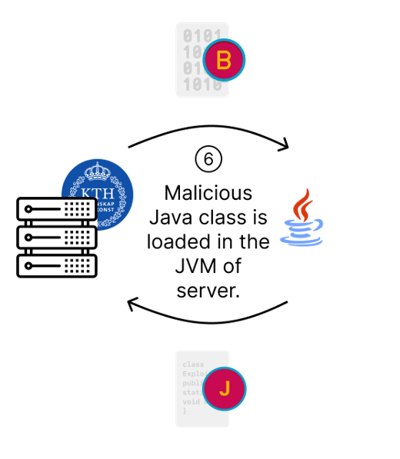
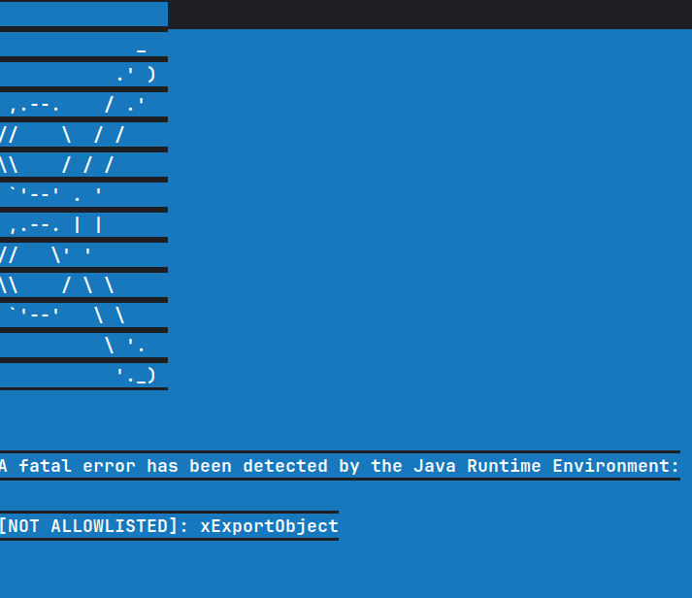
Step 2: Enforcement
Problem: Java class is simply loaded without any integrity.
Solution: We intercept loading and then verify it.
1) Load this class.
Java Application
Part 2 done ✅
4) Terminate and log incident
SBOM Runtime Watchdog
4) Can be executed.
Java Virtual Machine
2) Is the class there?
3) Yes
Bill of Material Index
(Allowlist)

Slide 23
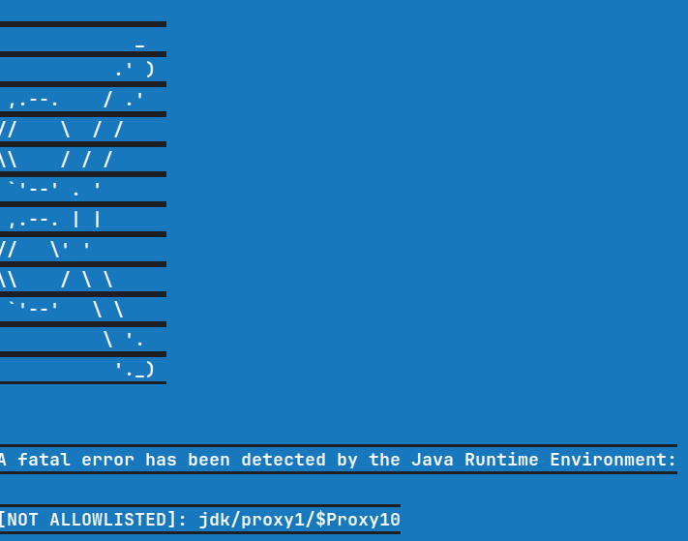
Test run
Okay, we seem to be done. Let’s see what happened initially.
Problem 1: There seems to be false-positives. This class
was in the allowlist.
Problem 2: There seems to be non-determinism in
runtime generated code.
Solution: Let’s ignore this non-deterministic features.

Slide 24
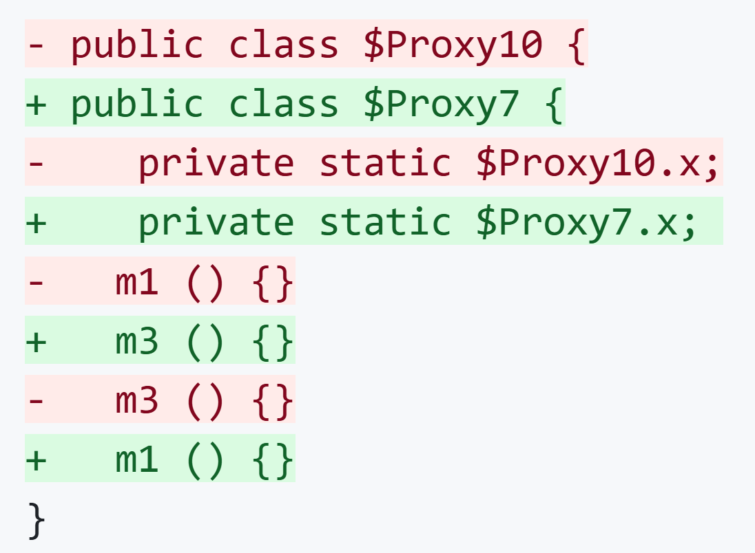
Bytecode Canonicalization
Classnames could change across different executions.
The type references change.
The order of method is not fixed.

Slide 25
Novel Concepts Summarised
Problem: what to index?
Solution: 3 indexers for built-in classes source code, dependencies, and dynamic code.
Problem: how to load class with verification
Solution: SBOM Runtime Watchdog is a novel tool to intercept Java classloading and verify integrity of each Java class.
Problem: non-determinism of Java bytecode.
Solution: Bytecode Canonincalization.
Problem: I miss blue screen of death in Linux (just kidding, no one likes kernel panic) ☹
Solution:

Slide 26
Demo: Mitigation
CVE-2021-44228 (Log4Shell)
Source: https://github.com/chains-project/exploits-for-sbom.exe/tree/main/rq2/log4shell-2021-44228
Notes:
Lets see the application it is a toy project
It can also be used for defining and loading classes
Let’s see how
To prevent it we run the two steps that we discussed before

Slide 27
Demo Steps (for replication later) for mitigation
To run with SBOM.exe protection, we follow two steps:
Run ./generate-index.sh. This outputs the index.jsonl which is the BOMI.
Run ./sbom.exe.sh. This would terminate the program just before the malicious class is initialized.

Slide 28
Evaluation
Notes:
Remove this slid

Slide 29
RQ1: What is the scale of BOMI for all the study subjects?
Methodology: Count classes in BOMI for all study subjects.
Key findings:
BOMI-Environment contains around 25,000 classes, varying with JDK vendors and versions.
BOMI-SupplyChain strongly depends on number of classes in dependencies. It is also much more complex as dependencies come from so many diverse organizations, unlike JDK classes.
BOMI-Runtime constitutes few number of classes, but they are extremely important to detect in order to prevent attacks.
Notes:
Too much text.

Slide 30
RQ1: What is the scale of BOMI for all the study subjects?
Methodology: Count classes in BOMI for all study subjects.
Key findings:
BOMI-Environment contains around 25,000 classes, varying with JDK vendors and versions.
BOMI-SupplyChain strongly depends on number of classes in dependencies. It is also much more complex as dependencies come from so many diverse organizations, unlike JDK classes.
BOMI-Runtime constitutes few number of classes, but they are extremely important to detect in order to prevent attacks.
Takeaway: Around 25,000 for the selected study subjects.
Notes:
Too much text.

Slide 31
RQ2: To what extent can SBOM.EXE mitigate high-profile attacks in Java?
Methodology: Replicate CVE-2021-44228 (Log4Shell), CVE-2021-42392 (H2 database console), and CVE-2022-33980 (Apache Commons Configuration) in a proof-of-concept and then run them with our BOMI and SBOM Runtime Watchdog attached.
Key findings:
It successfully prevent execution of the malicious class loaded at runtime in all 3 CVEs. In more technical terms, it is prevented from being initialized.
CVE-2021-44228 – mitigated
CVE-2021-42392 – mitigated
CVE-2022-33980 – mitiagted
Notes:
Big font: mitigate cve 1. 2. 3.

Slide 32
RQ2: To what extent can SBOM.EXE mitigate high-profile attacks in Java?
Methodology: Replicate CVE-2021-44228 (Log4Shell), CVE-2021-42392 (H2 database console), and CVE-2022-33980 (Apache Commons Configuration) in a proof-of-concept and then run them with our BOMI and SBOM Runtime Watchdog attached.
Key findings:
It successfully prevent execution of the malicious class loaded at runtime in all 3 CVEs. In more technical terms, it is prevented from being initialized.
CVE-2021-44228 – mitigated
CVE-2021-42392 – mitigated
CVE-2022-33980 – mitiagted
Takeaway: Mitigated all 3 CVEs successfully.
Notes:
Big font: mitigate cve 1. 2. 3.

Slide 33
RQ3: Is SBOM.EXE compatible with real-world applications?
Methodology: Create BOMI for real-world projects – PDFBox, TTorrent, and GraphHopper – and then run these projects with SBOM Runtime Watchdog attached.
Key findings:
SBOM.exe is fully compatible with PDFBox and TTorrent.
PDFBox:
Additional test for PDFBox Debugger
TTorrent:
Additional test to simulate torrent downloading
Update java bytecode for it to be compatible with Java 21
SBOM.exe is partially compatible with GraphHopper as one of the class names were randomly generated.

Slide 34
RQ3: Is SBOM.EXE compatible with real-world applications?
Methodology: Create BOMI for real-world projects – PDFBox, TTorrent, and GraphHopper – and then run these projects with SBOM Runtime Watchdog attached.
Key findings:
SBOM.exe is fully compatible with PDFBox and TTorrent.
PDFBox:
Additional test for PDFBox Debugger
TTorrent:
Additional test to simulate torrent downloading
Update java bytecode for it to be compatible with Java 21
SBOM.exe is partially compatible with GraphHopper as one of the class names were randomly generated.
Takeaway: Compatible with real-world projects.

Slide 35
RQ4: What is the overhead of SBOM.EXE?
Methodology: Measure performance using two metrics (using JMH) for 3 real world projects.
End-to-end time with warmup: Measure of the sum of how long it takes for the JVM to warm up and then run the application.
Workload time excluding warmup: Measure of the runtime of the application when all classes are fully JIT compiled (or optimized).
Key findings:
The overhead introduced by SBOM.EXE is negligible after warm-up.
SBOM.exe is suitable for production environments where warm-up is not a concern.

Slide 36
RQ4: What is the overhead of SBOM.EXE?
Methodology: Measure performance using two metrics (using JMH) for 3 real world projects.
End-to-end time with warmup: Measure of the sum of how long it takes for the JVM to warm up and then run the application.
Workload time excluding warmup: Measure of the runtime of the application when all classes are fully JIT compiled (or optimized).
Key findings:
The overhead introduced by SBOM.EXE is negligible after warm-up.
SBOM.exe is suitable for production environments where warm-up is not a concern.
Takeaway: Negligible overhead.

Slide 37
Future Work: Diff bytecode for reproducibility
Problem: Diffing bytecode to know reproducibility is not optimum as current diff tools also incorporate non-deterministic features while diffing.
javac v1
1 public static void main() {
2 print("Hello world!")
3 }
javac v2
// v1.class
Constant Pool:
#1 Hello World
#2 main
#3 print
...
$ diff v1.class v2.class
> bytecode differs
// v2.class
Constant Pool:
#1 print
#2 Hello World
#3 main
...
$ diff_can v1.class v2.class
> bytecode is same
$ diff_ast v1.class v2.class
> bytecode is same

Slide 38
Future Work: Which dependency is running?
Problem: Knowing (and verifying) what dependency is executing is hard because that information is lost while building the application.
Daniel Williams, “The Embedding and Retrieval of
Software Supply Chain Information
in Java Applications”, KTH, 2024
A. Sharma et al., “SBOM.EXE: Countering Dynamic Code Injection based on Software Bill of Materials in Java”, arXiv, 2024
We will be able to tell what dependency is running in real-time!
+
=
Key contribution: embeds dependency information in JVM bytecode.
One of the contribution: can tell which bytecode is running in real-time.
Notes:
You would want to do this for real time threat detection

Slide 39
Takeaways
SBOM.exe can mitigate three high-profile CVEs based on code generation and downloading.
SBOM.exe proposes a strong bytecode canonincalization algorithm which eliminates non-determinism in dynamic classes.
SBOM.exe can work well in production environment as shown by three real world projects.
Notes:
This can be contribution

Slide 40
Thank you! Questions?
Personal Webpage
Whitepaper
https://algomaster99.github.io
Aman Sharma
amansha@kth.se
Project Link: https://github.com/chains-project/sbom.exe
Whitepaper: SBOM.EXE: Countering Dynamic Code Injection based on Software Bill of Materials in Java
https://arxiv.org/abs/2407.00246

